Slide 1
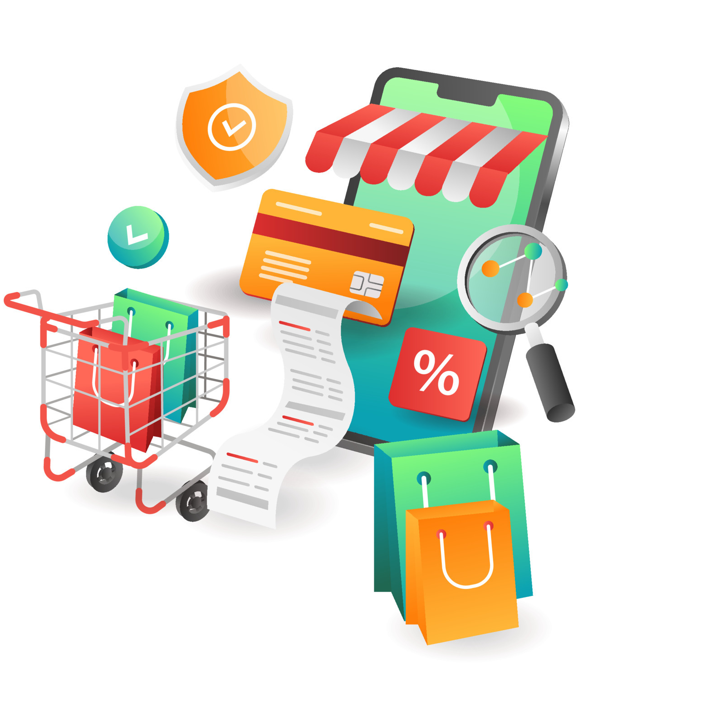
Online shopping List Notification (Observer Pattern)

Slide 2
Project is done by:
Kurri Nikitha
S.H.Nidhi
Sourabh Dipak Pawar
Sanket Anna Mahadik
Pratiksha Vinod Deshmukh

Slide 3
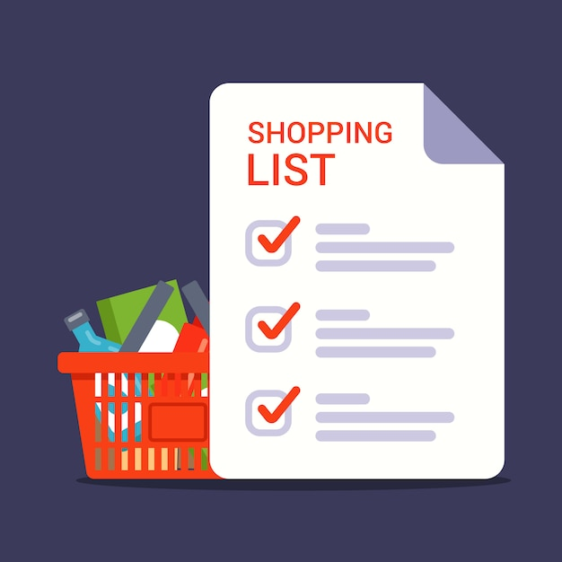
Abstract:
Shopping list notifications are a modern solution to the age-old problem of remembering what items to buy when shopping.
With the growth of technology and the ubiquity of smartphones, shopping list notifications have become increasingly popular.
These notifications provide users with timely reminders about items on their shopping lists, helping them to stay organized and save time.

Slide 4


SOFTWARE DETAILS:
This application is coded and made using the following compilers:
GDB Compiler.
Programming language CPP.
Ubuntu.

Slide 5
TECHNICAL REQUIREMENTS:
We used Classes and Objects, Inheritance and Polymorphism, Observer Design Pattern, STL Containers and Algorithms, Multithreading using C++ Threads in CPP while working on this.
Class : A class in C++ is the building block that leads to Object-Oriented programming. It is a user-defined data type, which holds its own data members and member functions, which can be accessed and used by creating an instance of that class.
An Object is an instance of a Class. When a class is defined, no memory is allocated but when it is instantiated (i.e. an object is created) memory is allocated.

Slide 6
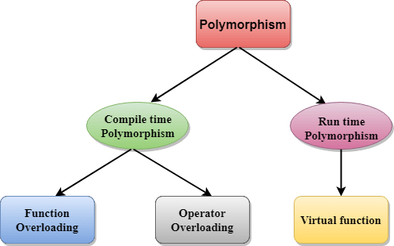
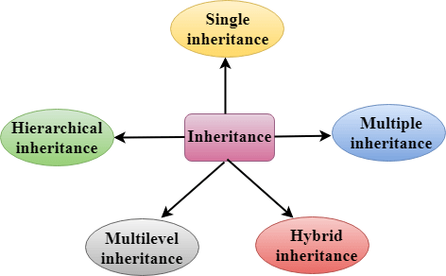
Polymorphism is that in which we can perform a task in multiple forms or ways.
It is applied to the functions or methods. Polymorphism allows the object to decide which form of the function to implement at compile-time as well as run-time.
Inheritance is one in which a new class is created that inherits the properties of the already exist class.
It supports the concept of code reusability and reduces the length of the code in object-oriented programming.

Slide 7
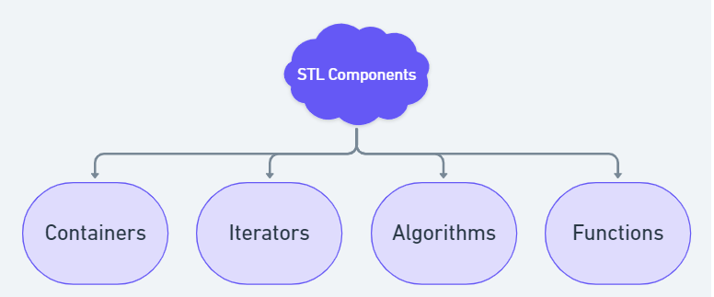
STL : The standard template library (STL) is a set of C++ template classes to provide common programming data structures and functions such as lists, stacks, arrays, etc. It is a library of container classes, algorithms, and iterators.

Slide 8
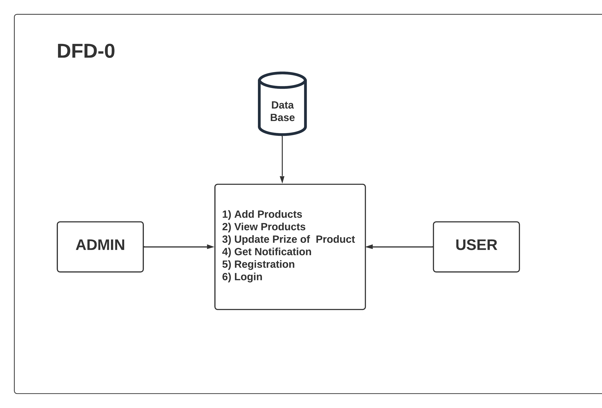
DFD Level-0

Slide 9
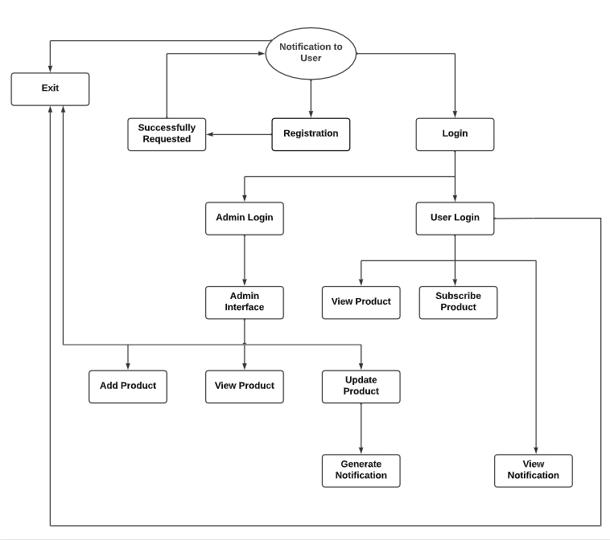
DFD Level-1

Slide 10
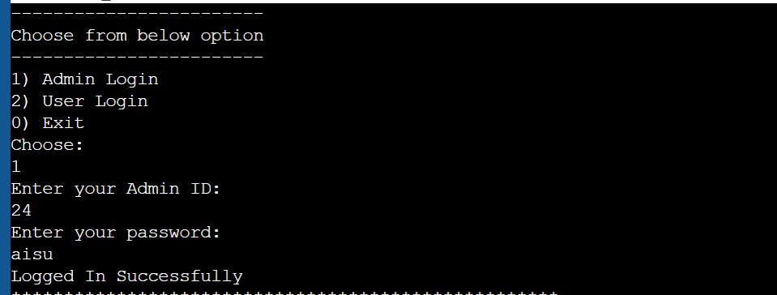
OUTPUT:
ADMIN LOGIN:

Slide 11
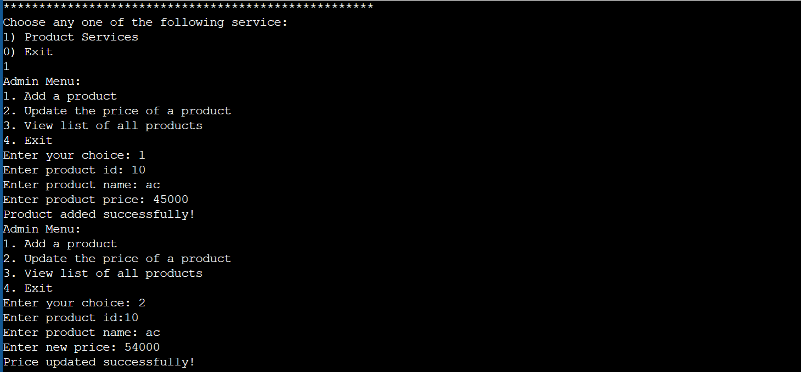
ADD PRODUCT & UPDATE PRODUCT:

Slide 12
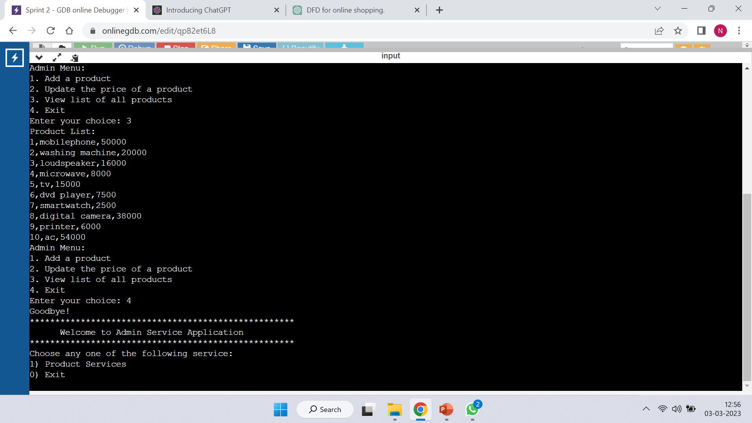
VIEW PRODUCT & EXIT:

Slide 13
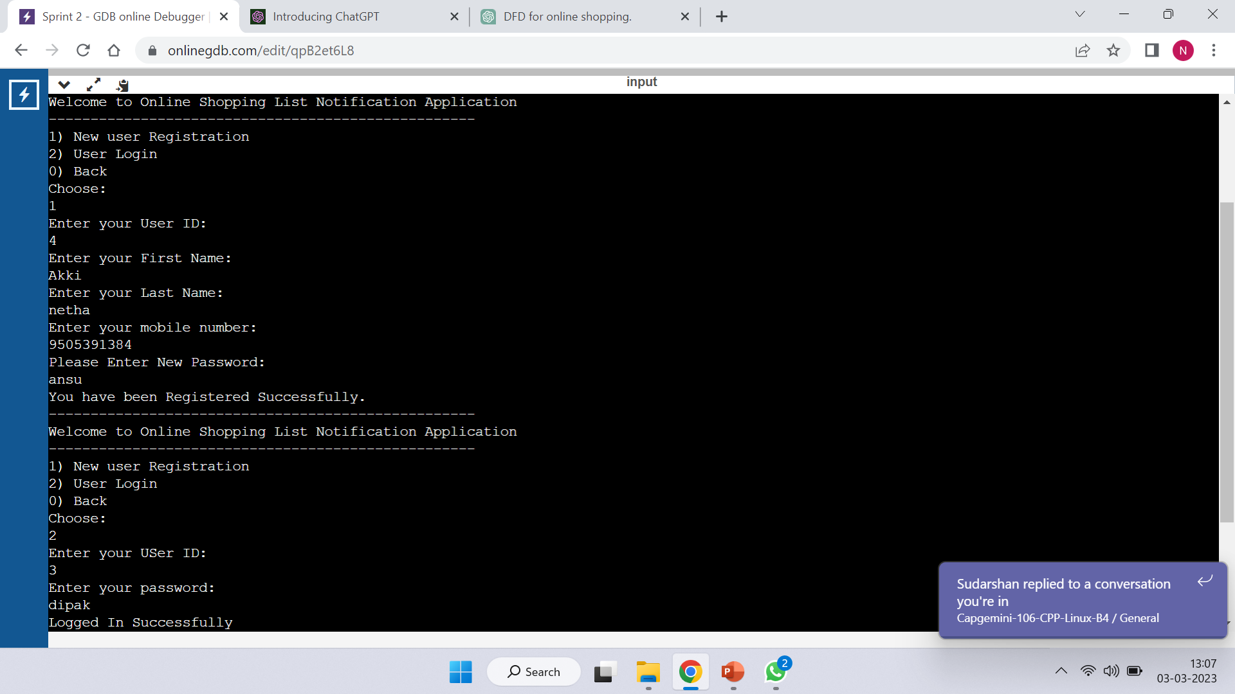
NEW USER REGISTRATION & USER LOGIN :

Slide 14
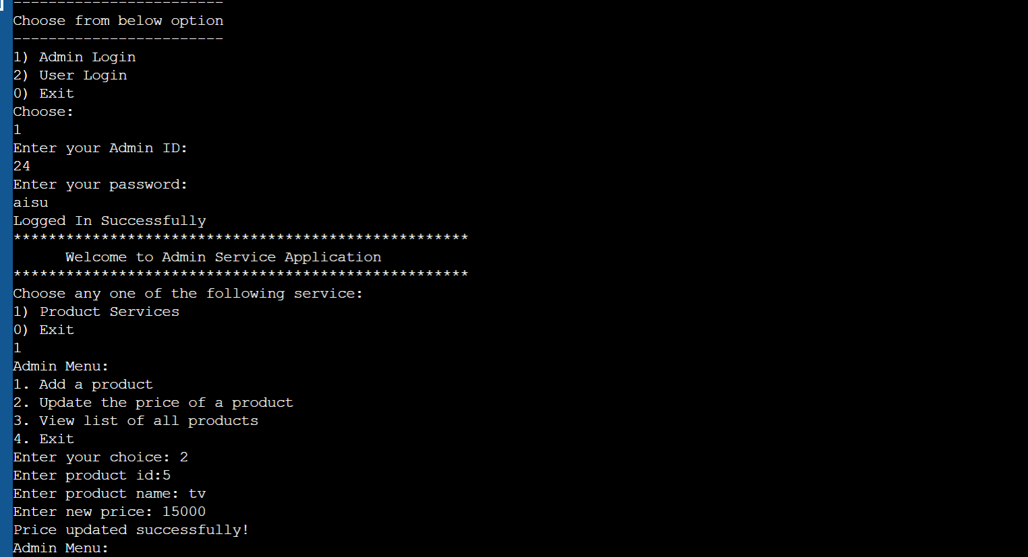
VIEW NOTIFICATION:

Slide 15
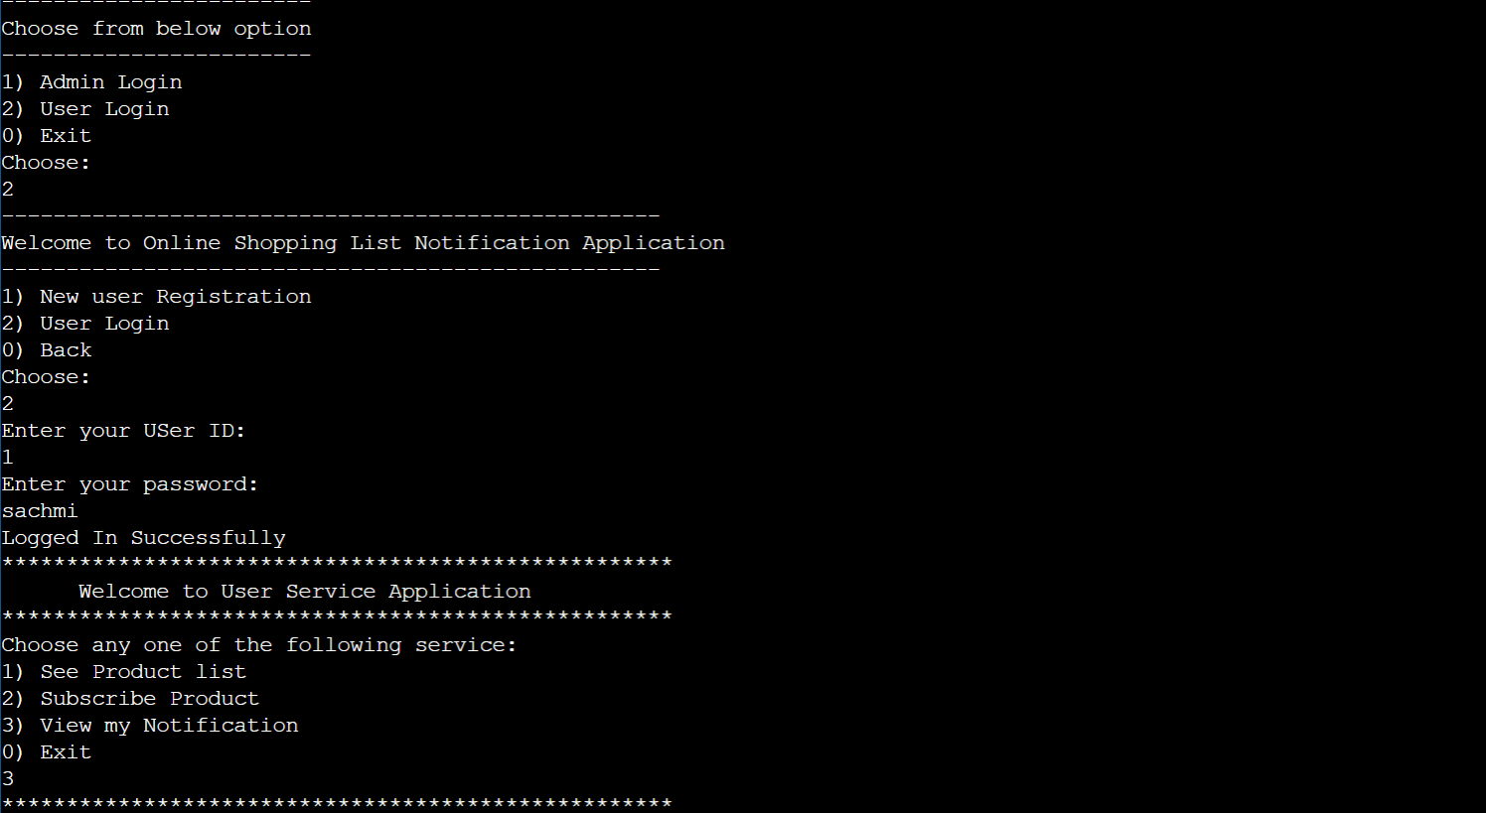
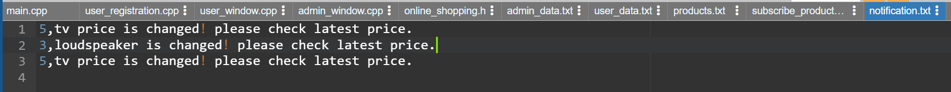

Slide 16
ADVANTAGES:
Time-saving : users can save time by not having to manually remember what they need to buy.
Avoidance of forgetting items : shopping list notifications ensure that users do not forget to buy any items on their list.
Better organization : shopping list notifications allow users to better organize their shopping trips by planning what they need in advance.
Smart shopping : shopping list notifications can be customized to provide smart shopping options, such as suggesting alternative products or providing price comparisons.

Slide 17

Further Enhances:
Dependence on technology : In cases where the user does not have access to their device, they may not receive the notification.
Technical errors: Technical errors, such as system glitches or app crashes, may prevent users from receiving the shopping list notifications.
Data security : Shopping list notifications require access to personal data, such as user location and purchase history.
Over-reliance: This could lead to reduced memory and recall skills over time.

Slide 18

THANKYOU

